Slide 1
JCM OSCE Questions CMC AED
7 Feb 2018

Slide 2
Case 1
An 86-year-old man fell forward with head injury in toilet at home. He attended ED complaining of immediate neck pain. He was able to walk afterwards and there was no limb numbness or weakness.
Physical exam showed tenderness over the neck region. Upper and lower limb power were full, sensation intact, normoflexia with normal tone.

Slide 3
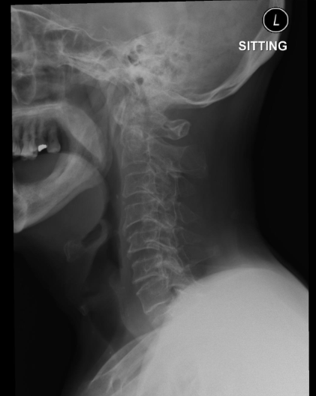
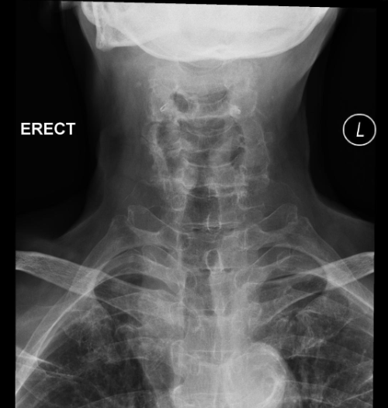

Slide 4
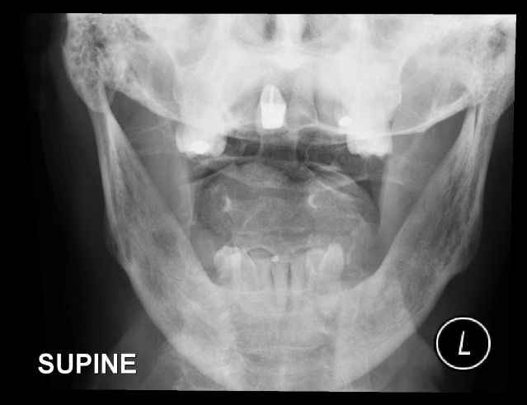

Slide 5
Case 1
Q 1: Name the abnormality in the X-ray C spine. (2 marks)
Q2: What is the diagnosis? (2 marks)
Q3: What is the most commonly used classification for this injury and how to classify? (2 marks)

Slide 6
Case 1
Q4: What is the common etiology in young and elderly patients respectively? (2 marks)
Q5. What are the treatment options for this patient? (2 marks)

Slide 7
Case 2
A 25 months old child fell from 20cm height while playing on a gym-machine for “rotating exercise”. He landed on the ground with left foot and then fell down due to imbalance. He was unable to walk afterwards. No other injury was noted.
Physical examination showed no external wound and mild tenderness was noted at distal left tibia. Examination on left hip, knee and ankle were unremarkable.

Slide 8
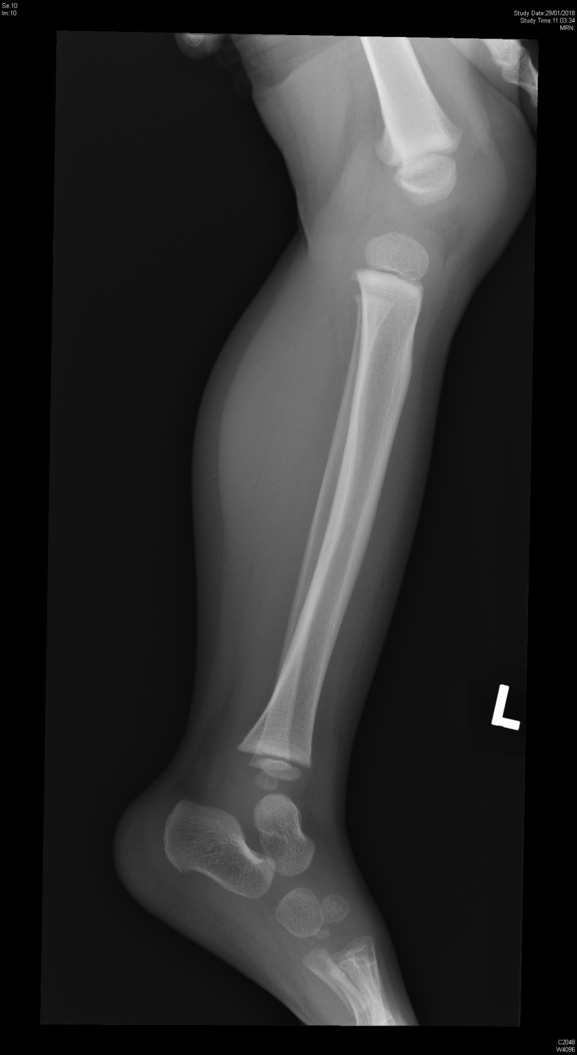
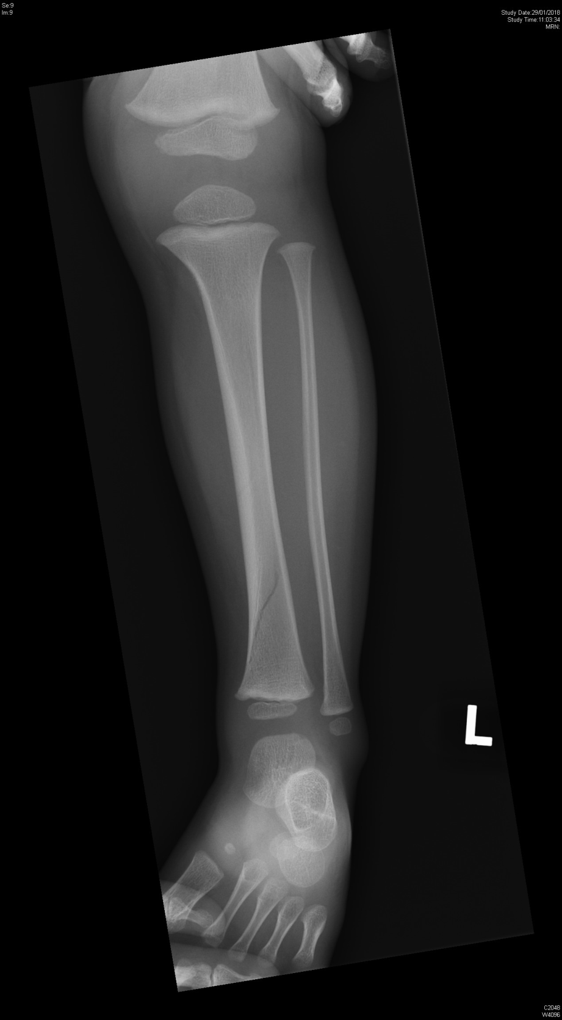

Slide 9
Case 2
Q1: Here are the x-rays of this child, what is the finding? (1 mark)
Q2: Name one differential diagnosis of the above finding (1 mark)
Q3: Name two complications of the above condition (2 marks)

Slide 10
Case 2
Q4: How would you manage this child? (2 marks)
Q5: Name one associated condition you would consider. (1 mark)
Q6: How you manage the child if the condition mentioned in question 5 is suspected? (2 marks)

Slide 11
Case 3
55-year-old female presented with cough and whitish sputum for half month. She has good past health and is a non-smoker, non-drinker. There was no recent travel history. Her temperature was 38ºC. Other physical findings were essentially normal.
Below is her Chest X-ray taken on day of presentation.

Slide 12
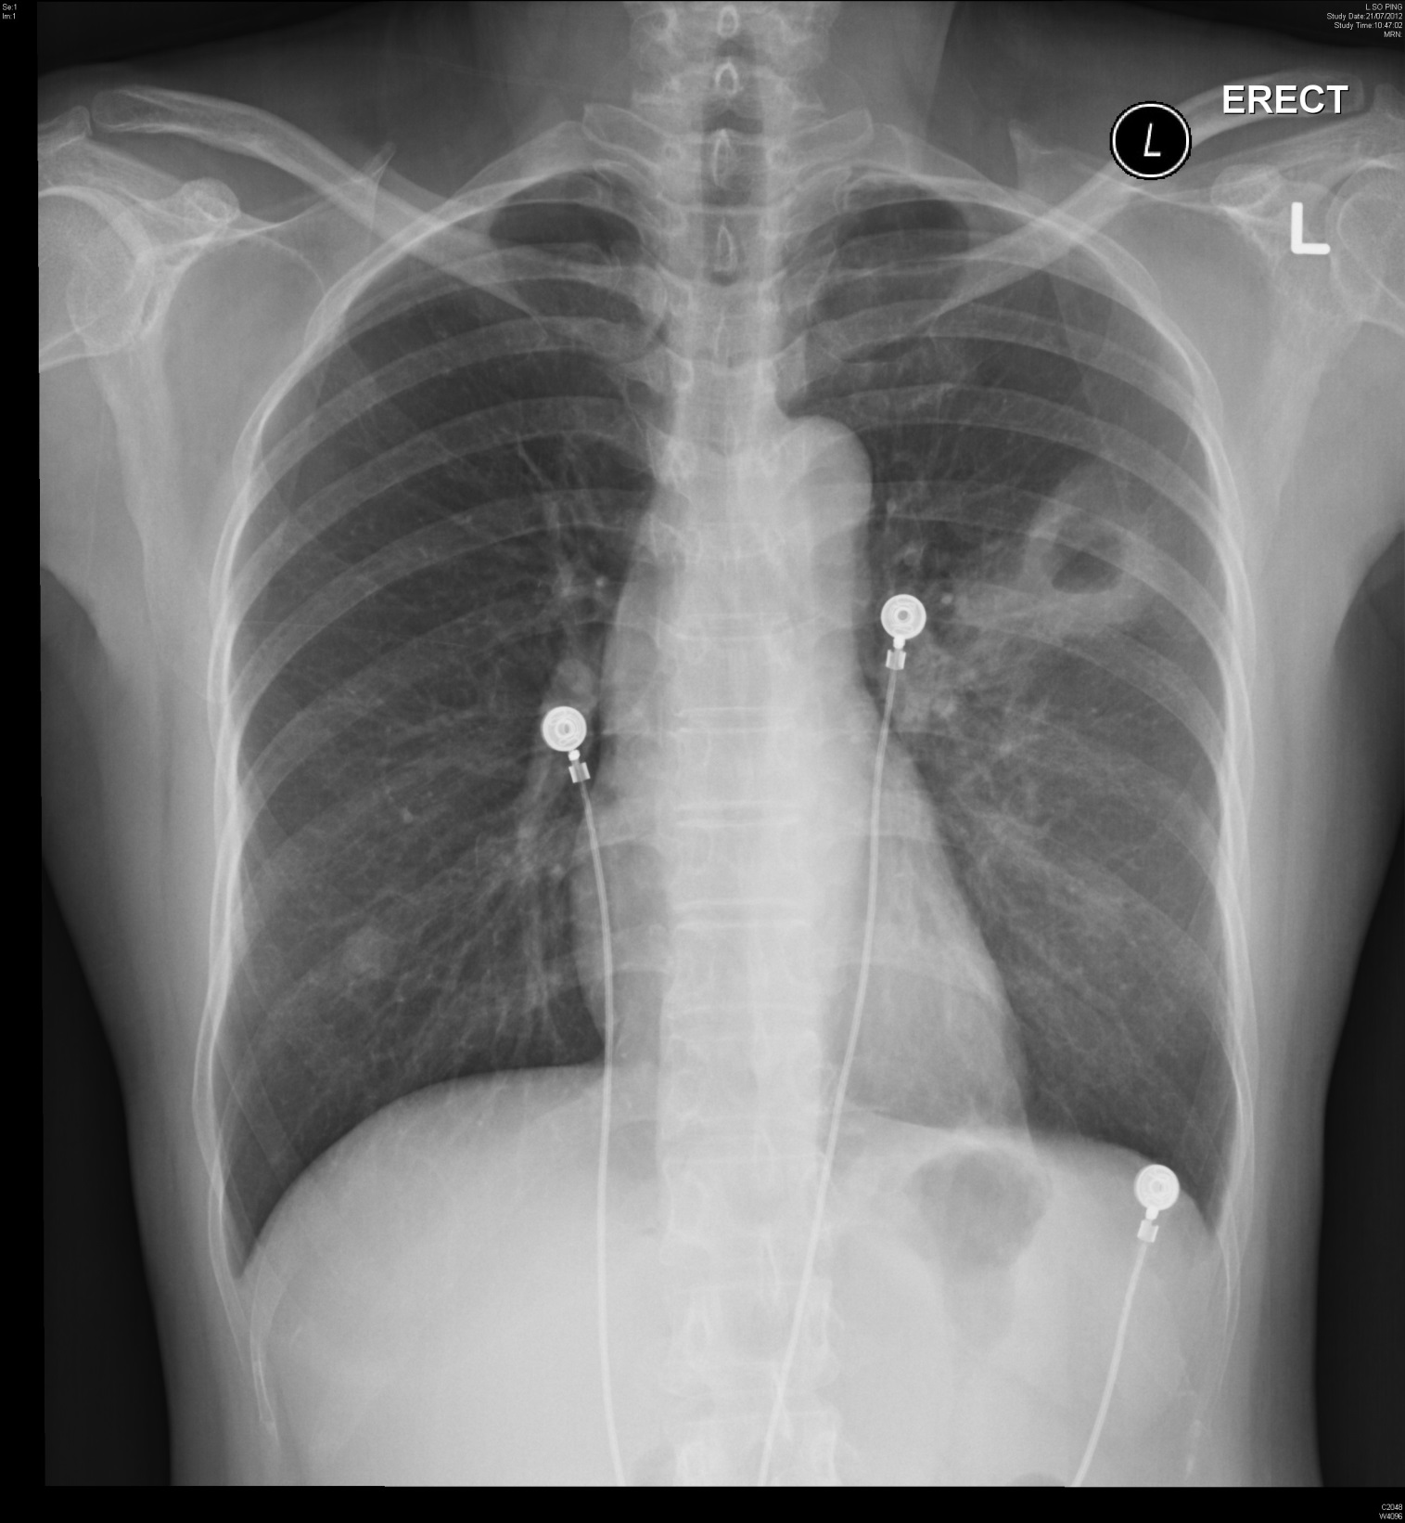

Slide 13
Case 3
Q1: Name the radiological findings. (3 marks)
Q2: Name 3 types of lung infections and one corresponding causative organism for each type that may present with this XR finding. (3 marks)
Q3: Name 3 other causes for such XR finding. (3 marks)

Slide 14
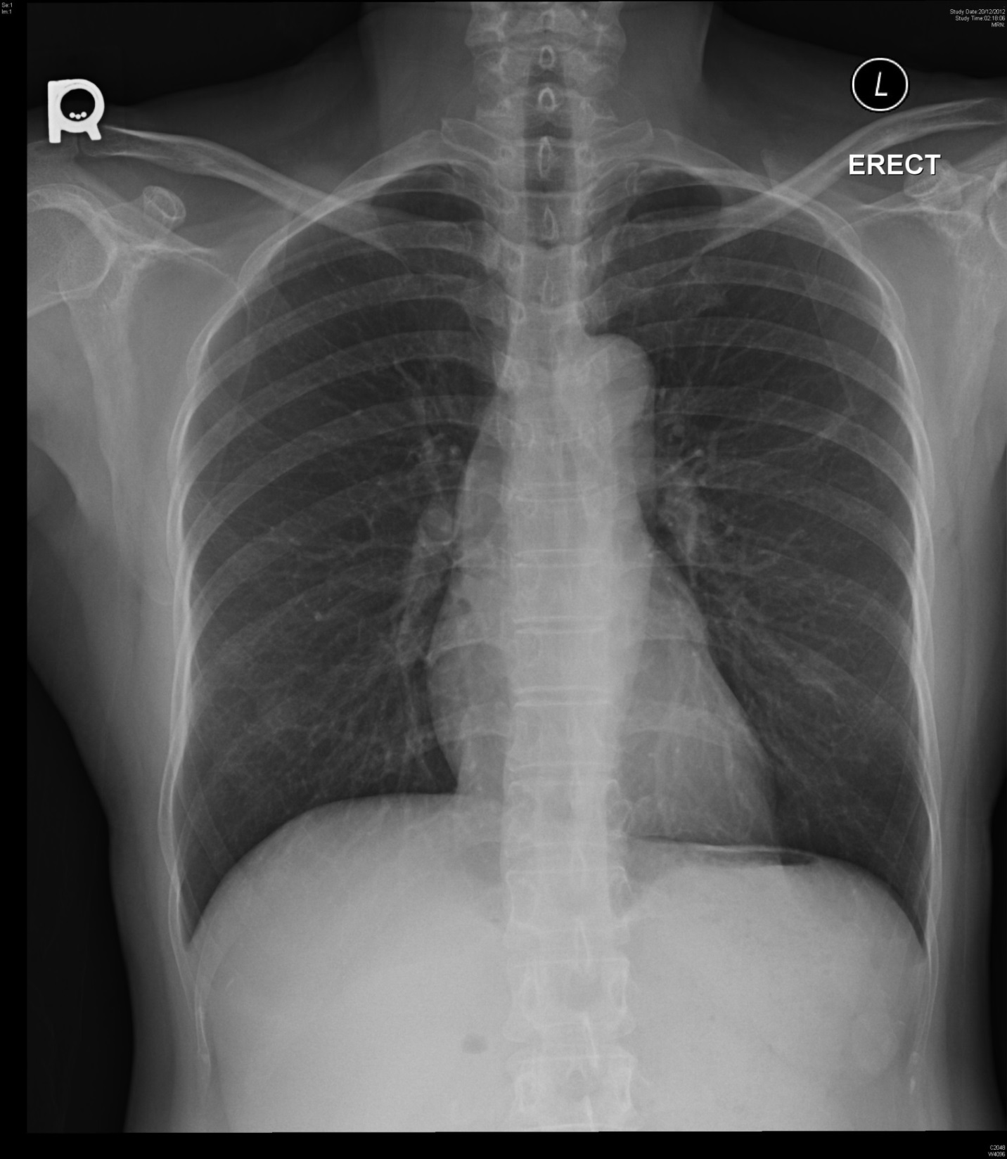

Slide 15
Case 3
Q4: Below is her chest X-ray after 5 months. What treatment is likely received by her? (1 mark)

Slide 16
Case 4
39-year-old female had a nap when she was home after work at 5pm. She woke up with dizziness, headache and repeated vomiting of undigested food at 6pm. When her husband went home at 7pm she was sent to A&E Department by ambulance. She was fully conscious on arrival and was put in sitting position (which she preferred) in a trolley. Her blood pressure was 129/90 mmHg, pulse 73/min regular. No focal neurological deficits were found. She had good past health.

Slide 17
Case 4
Q1. Name three categories of important differential diagnosis you have to think of. (2 marks)
Q2. Below is one of her CT brain cut. What is the diagnosis. (2 marks)
Q3. Name three more clues to your above diagnosis, not given to you in the history and physical examination mentioned above. (3 marks)

Slide 18
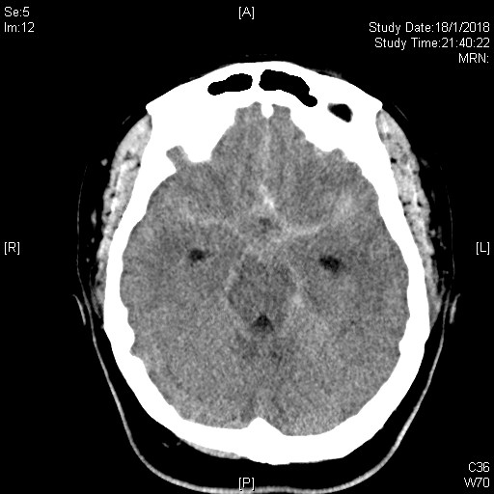

Slide 19
Case 4
Q4. If the first CT brain (plain) was normal, name three differential diagnoses now in descending order of possibility. (2 marks)
Q5: Name two further investigations that may be done on this patient. (1 mark)
Q6: Name two possible inventions this patient may receive for definitive care to prevent recurrence. (1 mark)

Slide 20
Case 5
A 52-year-old gentleman took around 60 gram of mothballs for suicide. He grounded the mothballs into powder before ingestion. He complained of malaise and passed dark brown urine 20 hours after ingestion.

Slide 21
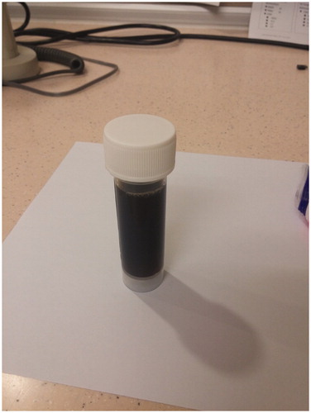
Dark urine of our patient 20 h after mothballs ingestion.

Slide 22
Case 5
Q1. Name 3 common ingredients of mothballs. (3 marks)
Q2. What is the most likely diagnosis in this patient? (2 marks)
Q3. Why were his symptoms occurred at 20 hours after ingestion? (2 marks)
Q4. The patient brought along the ‘mothball powder’ of unknown ingredient. How will you identify the ingredient in AED? What physical property of the mothball ingredient do you test for? (2 marks)

Slide 23
Thank you!

